Slide 1
Introduction to Data Visualization with Tableau
Final Project by Ali Hasnain Khan Sial
Student ID: 2101974
Submission Date: 10/25/2021

Slide 2
Overview
Dataset:
For this project the dataset selected is “HR Data”
Topic:
“Organisation’s Workforce Structure In Comparison to Turnover Cycle”
Aim:
With this dataset, I wanted to analyze the workforce structure of this business. Knowing the core strength of the organisation, understanding demographics such as gender and race distribution and comparing it with the organistaion’s turnover cycle, was of keen interest.
Process:
In order to achive the overall aim, two dashboards with some supporting dashboards have been prepared which will assisst in presenting the true picture of workforce structure of the organisation.
Dashobard 1: Human Resource Workforce Dashobard
Dashbord 2: Employee Turnover Dashboard
I imagined myself as the Human Resource Manager at this orgnisation producing a dashboard for the senior management. The dashboards aim not only to provide an overview of the organisation but also assisst in making informed decisions about hiring and terminations in the future.
The data was vast which required thorough cleaning. No measure values were available which required few calculated fields and treatment for large amounts of null values. The entire step by step process to produce a meaningful dashboard is included in this document.

Slide 3
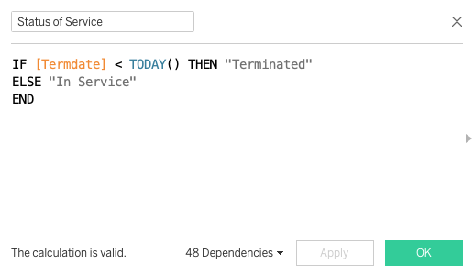
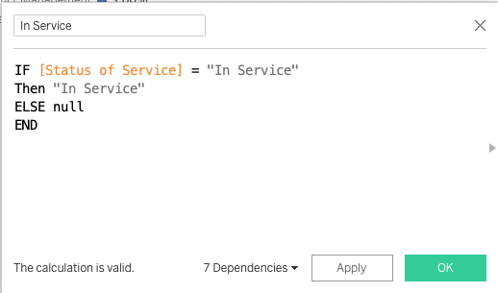
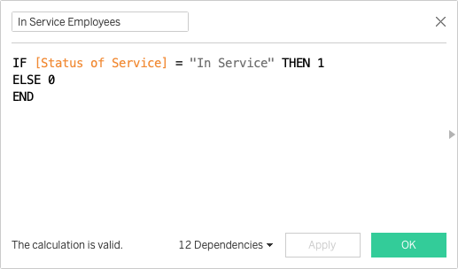
Calculated Fields
Status of Service:
In order to determine the difference between who is an active “In Service” employee or whom has left and is “Terminated” for this large organisation/dataset the field Status of Service was created. A new column was added to the data with “In Services” and “Terminated” employees. This calculation acted as the foundation on which the further analysis was built. The formula for this calculation is:
﻿IF [Termdate] < TODAY() THEN "Terminated”
ELSE "In Service"
END
In Service:
Using Status of Service, another column was created to differentiate the active employees from the terminated ones. Formula used:
﻿IF [Status of Service] = "In Service"
Then "In Service"
ELSE null
END
“In Service Employees”, a measure value was also created using this field for further analysis. Formula used:
﻿IF [Status of Service] = "In Service" THEN 1
ELSE 0
END

Slide 4
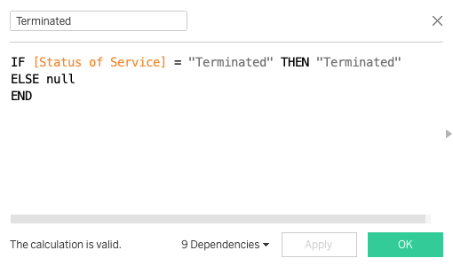

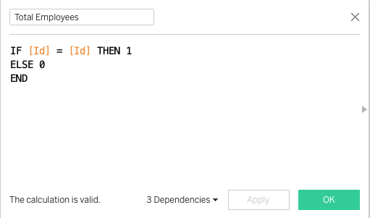
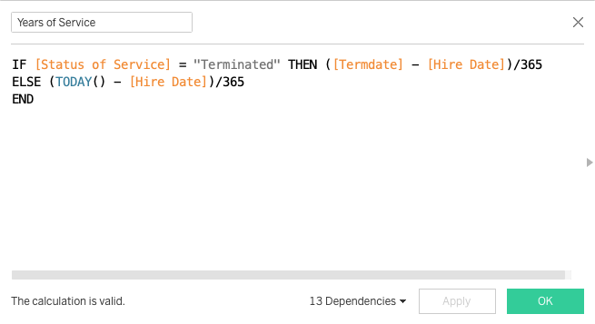
Calculated Fields …
Terminated:
Using Status of Service a column was created to highlight employees who had been terminated. Formula used:
IF [Status of Service] = "Terminated" THEN "Terminated"
ELSE null
END
“Terminated Employees”, a measure value was also created using this field for further analysis. Formula used:
﻿IF [Status of Service] = "Terminated" THEN 1
ELSE 0
END
Total Employees:
To calculate total employees of the organisation. Formula used:
﻿IF [Id] = [Id] THEN 1
ELSE 0
END
Years of Service:
To determine how long the employees have been with the organisation or in case of termination how long their employment was, this field was created. Formula used:
﻿IF [Status of Service] = "Terminated" THEN ([Termdate] - [Hire Date])/365
ELSE (TODAY() - [Hire Date])/365
END

Slide 5
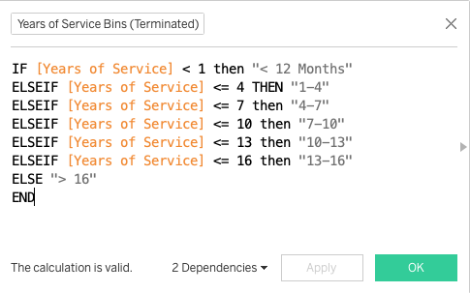
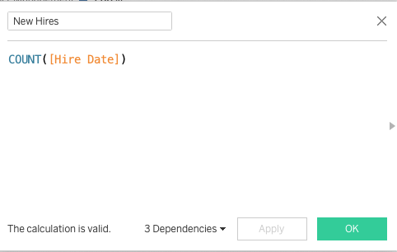
Calculated Fields …
﻿Years of Service Bins (In Service):
Using Years of Service as a standard 2 year bin for In Service employees was created using the standard creating bin procedure in tableau.
﻿Years of Service Bins (Terminated):
Using Years of Service a custom bin field was created to determine the termination cycles as follows:
﻿IF [Years of Service] < 1 then "< 12 Months"
ELSEIF [Years of Service] <= 4 THEN "1-4"
ELSEIF [Years of Service] <= 7 then "4-7"
ELSEIF [Years of Service] <= 10 then "7-10"
ELSEIF [Years of Service] <= 13 then "10-13"
ELSEIF [Years of Service] <= 16 then "13-16"
ELSE "> 16"
END
New Hires:
Hire Date was used to calculate the new hires every year by the company and the formula used was:
﻿COUNT([Hire Date])

Slide 6
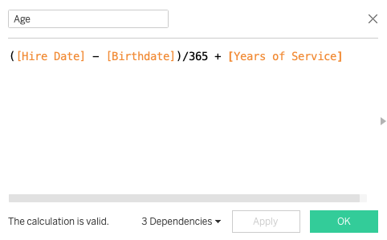
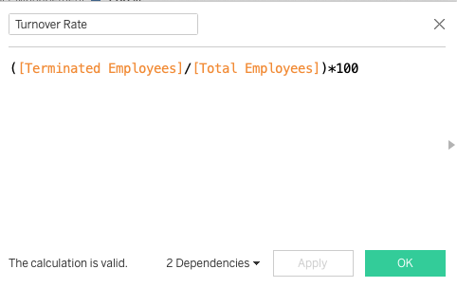
Calculated Fields …
﻿Age:
To calculate age of workforce the following function was used:
﻿([Hire Date] - [Birthdate])/365 + [Years of Service]
Turnover Rate:
Using Terminated Employees and Total Employees the Turnover Rate for the organisation was calculated. The formula used:
﻿([Hire Date] - [Birthdate])/365 + [Years of Service]

Slide 7
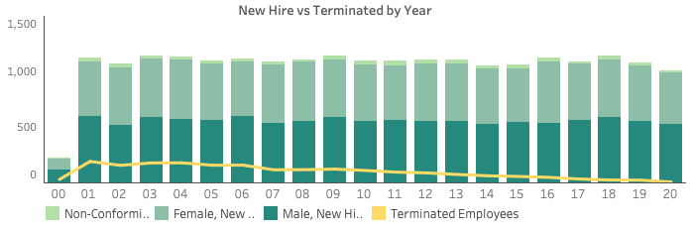
Analytical Questions
Mentioned below are the analytical procedures designed to achieve the aims outlined previously. There are two dashboards with three overarching questions and sub questions within them.
The basic assumptions for all the calculations mentioned above and the graphs displayed below are as follows:
The age of employees was not incorporated except for the calculation of avergae age of In Service employees because the data included few employees with unrealistic ages when they joined the workforce. Thus the age aspect of filtering employees was not included to avoid complexity in analysis.
The data also included large amounts of null values which were filtered out while answeing analytical questions via filters.
Dashboard 1: Human Resource Workforce
When? (breaking down data chronologically)
Question 1: Number of employees being hired every year by gender against the terminations taking place every year?
Answer: As per the graph the organisation has a steady and constant hiring environment with very few terminations every year (please see the screenshot below)
A duel axis graph of a histogram and a line chart was selected for this comparison as both of these are considered equally good measures of analysing distribution and trends over the years.

Slide 8
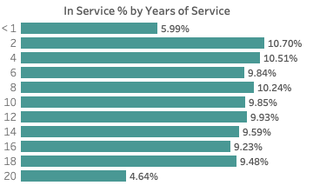
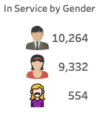
Analytical Questions
Question 2: Percentage of In Service employees by years of service bins to determine if the workforce is experienced or unexperienced?
Answer: The histogram presents that more than 50% of the current workforce has been with the organisation for more the 8 years suggesting that employees generally have a longer tenure at the organisation (please see the screenshot below)
The histogram was selected as the chart to represent data as one of the variables being used was of chronological nature.
Who? (Employees who were part of the workforce)
Question 1: What is the gender breakdown of the workforce?
Answer: please see the screenshot below

Slide 9
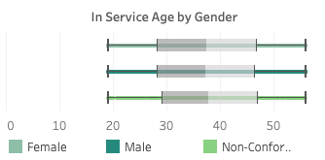
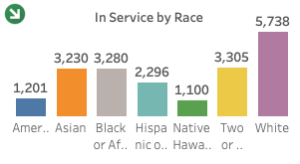
Analytical Questions …
Question 2: What is the age distribution of employees in the organistaion based on gender?
Answer: The box and whisker plot indicates that majority of the workforce is within the age range 20 years - 57 years having a median of 37-38 years (please see the screenshot below)
The box and whisker plot was considered reasonable to present this distribution as it provides a clear visual to show mean, median and range distribution for data being analysed which was the aim of this question
Question 3: What is the race distribution of the workforce to determine if the hiring process is unjust in any way?
Answer: Race difference suggests that the largest race in workforce is white with reasonable amount of employees from other races (please see the screenshot below)
A bar chart was selected to display this distribution of data since the comparison of the workforce was based on which race they belonged to. The height of the bar chart makes it easier for the viewer to understand this comparison even without reading the numbers

Slide 10
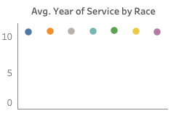
Analytical Questions
Question 4: Analyzing the average years of service for employees in the organization by race?
Answer: As per the data the average years of service for all races in the workforce appears to be between 10 years to 11 years which further indicates towards a strong experienced organisation structure (please see the screenshot below)
A dot chart was chosen for this answer since it looked visually appealing to use different colour dots to show each race’s average while also the displaying comparison among them
A legend wasn’t provided for this chart since the visual next to it, in the dashboard, is also showing race distribution which identifies the colour associated to each race and the same colours were used in this chart

Slide 11
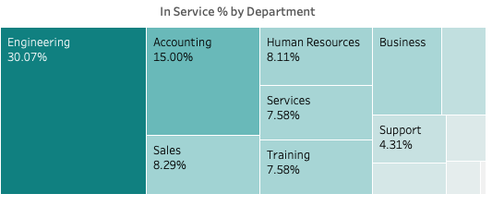
Analytical Questions
Where? (department, office and home town analysis)
Question 1: Percentage of employees in each department to display the department with the largest slice of workforce?
The chart breaks down the division of employees in the organisation by departments with engineering department having highest amount of employees which is 30.7% of the entire workforce (please see the screenshot below)
The treemap was used to present the data based on department strength. This chart allows the shape of boxes to be arranged as per the size of the variable which provides the viewer with a clear visual to understand the size difference even without reading the associated numbers

Slide 12
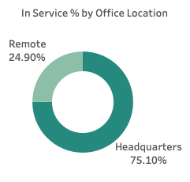
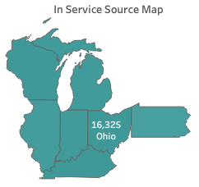
Analytical Questions
Question 2: Comparing the workforce distribution based on the location of office from which they operate?
Answer: The graph below displays that more than 75% of the workforce operates from headquarters while only 24.9% of the employees work remotely
A donut chart for this comparison was select, even though it is not recommended anymore to display data, but since only two variables were being compared the chart provides the view for the user to understand this distribution
Question 3: Number of employees based on their home state to analyse where the majority of workforce is being sourced from?
Answer: The map below shows that 80% of employees are being sourced from Ohio and very small amounts belong to other states
A map was used to present this data because it will provide the view to easily understand the geographical location of different home states of the employees

Slide 13
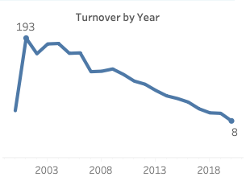
Analytical Questions
Dashboard 2: Employee Turnover
When? (breaking down data chronologically)
Question 1: Number of employees being terminated or leaving the company every year?
Answer: The graph below points towards a positive trend for the organisation as the number of employees leaving the company each year is constantly decreasing, thus suggesting that employees being hired tend to stay with the organisation for longer terms
A line chart was select to display this answer since it provides the viewer with a clear visual of decreasing trend over the years

Slide 14
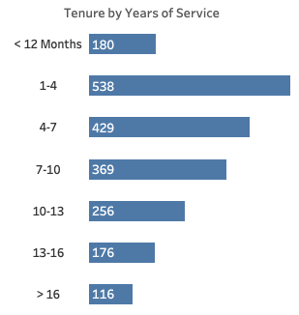
Analytical Questions
Question 2: How many years of service did the employees have at the time of termination?
The histogram below suggests that majority of the terminations occur in the 1-4 year of service at the organisation with a decreasing trend in termination as years of service increases
Histogram was mainly selected for this distribution because custom made bins were being used to understand the chunk of years with highest terminations, also to analyse the tails/trends before and after the highest frequency as well
The custom bins used were mentioned in the calculated fields

Slide 15

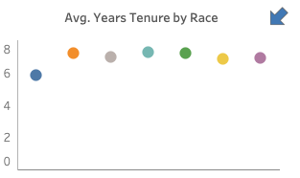
Analytical Questions
Who? (Who was is part of the workforce)
Question 1: What is the gender breakdown of the terminations?
Answer: please see the screenshot below
Question 2: Analyzing the average years of service for employees who have been terminated by race?
Answer: The graph suggests that average year of service for employees belonging to all races who have been terminated is around 7-8 years
A dot chart was chosen for this answer since it appeared visually appealing to use multicolour dots to represent each race’s average and the comparison between them
A collective legend for this graph and next graph was provided in the dashboard

Slide 16
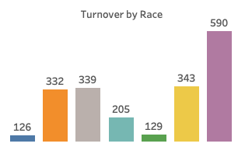
Analytical Questions
Question 3: What is the race distribution of the employees leaving the organisation?
Answer: Race difference suggests that race with most terminations is white with reasonable amount of employees from other races (please see the screenshot below)
A bar chart was selected to display this distribution of data since the comparison of the terminations was based on which race they belonged to. The height of the bar chart makes it easier for the viewer to understand this comparison even without reading the numbers

Slide 17
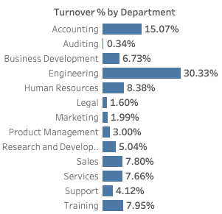
Analytical Questions
Where? (department, office and home town analysis)
Question 1: Percentage of total terminations from each department?
The largest amount of termination as per the departments are from Engineering (30.33%) which is consistent with workforce structure of the organisation
A bar chart was used to display this distribution to make it easier for the viewer to differentiate between number of employees being terminated from each department

Slide 18
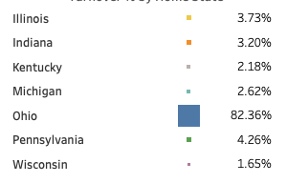
Analytical Questions
Question 2: Number of employees being terminated based on their home state?
Answer: Most terminations are for the employees belonging to Ohio State, which is consistent with the organisation’s workforce as more than 80% them belong to Ohio
A heat map was thought to be visually useful to represent the size difference between terminations belonging to Ohio as compared to the rest

Slide 19
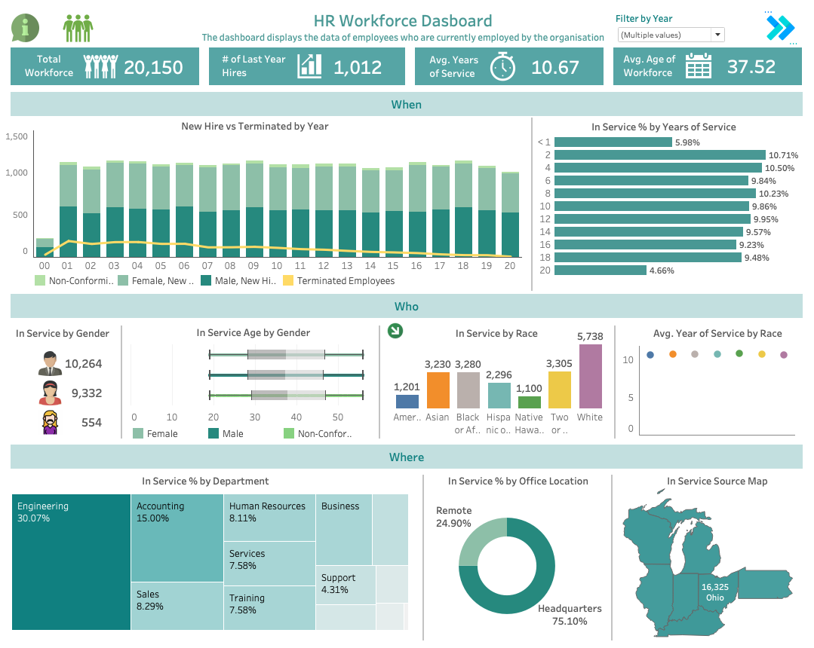
Dashboard 1: Human Resource Workforce

Slide 20
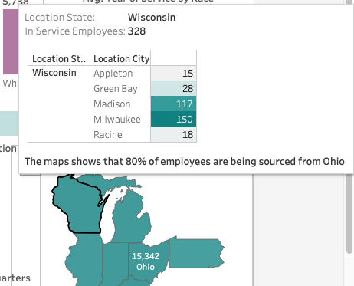
Dashboard 1: Human Resource Workforce …
Summary
The dashboard provides summarised analysis for the current workforce of the organisation . This dashboard will act as a main tool for the HR Department to monitor company’s progress as well as having easy access to all records. Below you can find information on how to navigate around this dashboard.
Info Icon
As show in the screenshot below there is info icon on the top left corner of the screen. It provides all the information the view needs to navigate around the dashboard. It also provides information regarding interactions that viewer can perform on the dashboard such as tooltips, filters, drill downs etc. The colour given to the icon is different then the colour pallet select for the entire dashboard to draw viewers attention quickly
The dashboard is divided into three sections to facilitate the viewer in understanding the flow and division of information. These questions are further divided into sub-questions as mentioned in the analytical questions section. ( For details and uses please refer to that section. The three sections are:
When?
Who?
Where?
Hovering over charts will provide a meaningful insight about the graph such as show below:

Slide 21
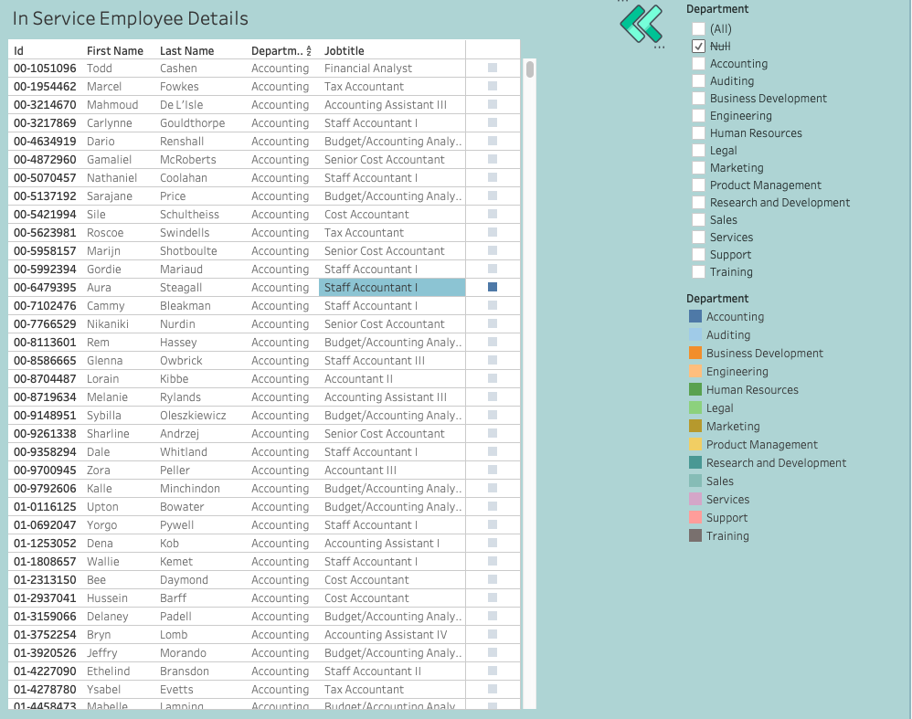
Dashboard 1: Human Resource Workforce …
The green people icon next to this info icon will navigate you to the dashboard with few insights on employee profile such as "Name", "Department", "Job Title". To do so please click on the icon once in dashboard mood
To filter data by year, do this by unchecking all the other years in the "filter by year". You can use the same filter to compare multiple years data
Data can be filtered by gender, to do that please click on the icons of genders provided in the section under "In Service by Gender"

Slide 22
Dashboard 1: Human Resource Workforce …
Data can also be filtered based on race, to do that hold alt/option and click on the green arrow in the section "In Service by Race". It will show you the hidden filter and you can choose from the options below. Also to hide/exit the filter please hold alt/option and click on the big "X"
Filter the data/dashboard by Departments. There is a further drill down available for the departments if you wish to know insights of workforce based on departments and job titles. Please click on the department in the "In Service % by Department" to filter data or to further drill down to job title details
Hover over the map at the corner under "In Service Source Map" and hover over it to see the details of the employees by city
The blue arrow on the top right corner of this dashboard will navigate you to the "Employee Turnover Dashboard". Please click on it to do so

Slide 23
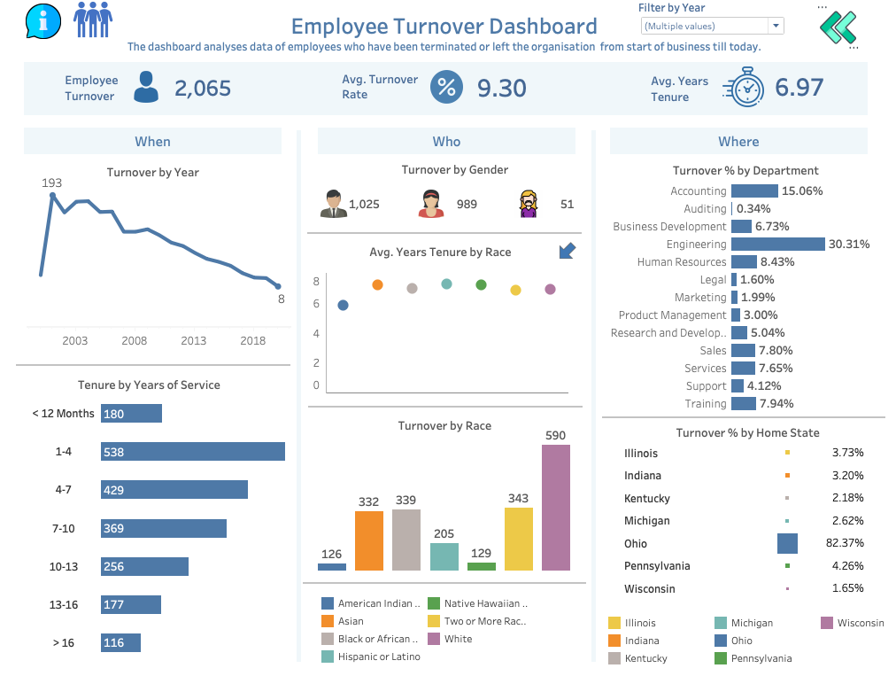
Dashboard 2: Employee Turnover

Slide 24
Dashboard 2: Employee Turnover …
Summary
The dashboard provides summarised analysis for the terminated employees of the organisation . This dashboard will act as a main tool for the HR Department to report on success of the department in terms retaining employees, as well as having easy access to all records. Below you can find information on how to navigate around this dashboard.
Info Icon
As show in the screenshot below there is info icon on the top left corner of the screen. It provides all the information the view needs to navigate around the dashboard. It also provides information regarding interactions that viewer can perform on the dashboard such as tooltips, filters, drill downs etc. The colour given to the icon is different then the colour pallet select for the entire dashboard to draw viewers attention quickly
The dashboard is divided into three sections to facilitate the viewer in understanding the flow and division of information. These questions are further divided into sub-questions as mentioned in the analytical questions section. ( For details and uses please refer to that section. The three sections are:
When?
Who?
Where?

Slide 25
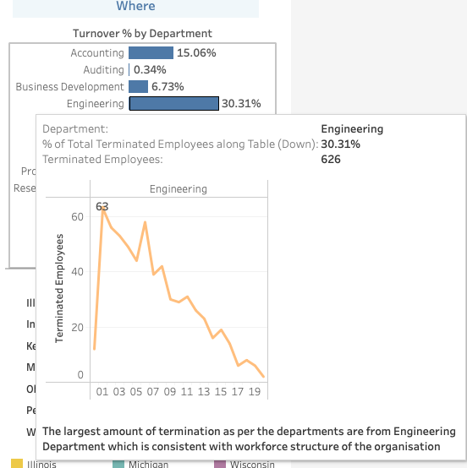
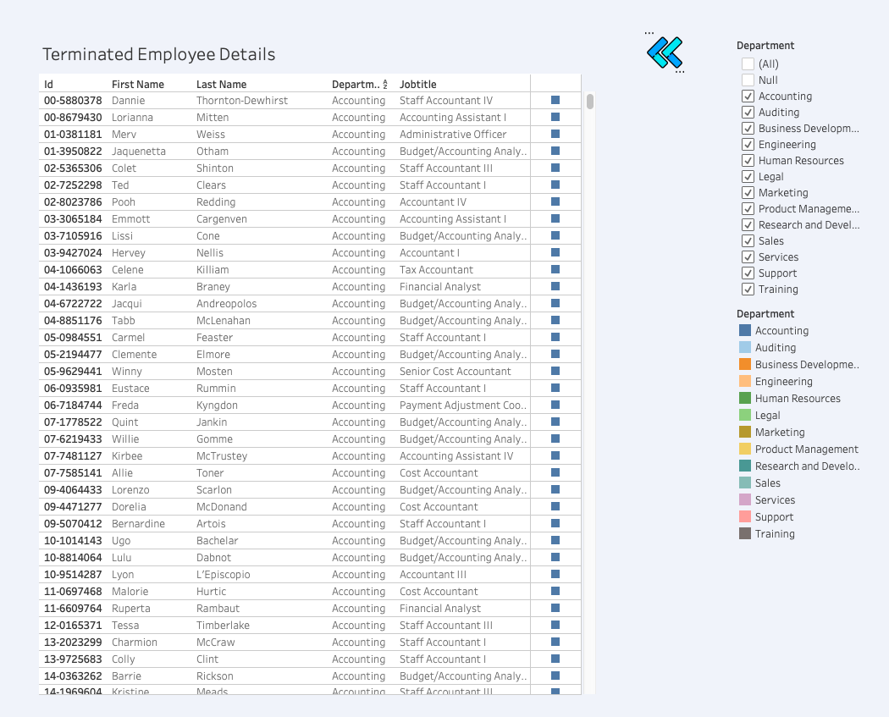
Dashboard 2: Employee Turnover …
Hovering over charts will provide a meaningful insight about the graph such as show below
The blue people icon next to this info icon will navigate you to the dashboard with few insights on terminated employee profile such as "Name", "Department", "Job Title". To do so please click on the icon once in dashboard mood

Slide 26
Dashboard 2: Employee Turnover …
Filter data by year, do this please uncheck all the other years in the "filter by year". The same filter can be used to compare multiple years data
Data can be filtered by gender, to do that please click on the icons of genders provided in the section under "In Service by Gender"
Filter data based on race, to do that please hold alt/option and click on the blue arrow in the section "Avg. Year Turnover by Race". It will show you the hidden filter and you can choose from the options below. Also to hide/exit the filter please hold alt/option and click on the big "X"
You can also filter the data/dashboard by Departments. There is a further drill down available for the departments if you wish to know insights on terminations based on departments and job titles. Please click on the department in the "Turnover % by Department" to filter data or to further drill down to job title details. You can also hover over the chart to yearly trends of termination with in the department as well
The green arrow on the top right corner of this dashboard will navigate you back to the "HR Workforce Dashboard". Please click on it to do so

